Slide 1
Topic-ANN CLASSIFICATION
Presented by :- Tetali ram subba reddy Date-15-02-2023
Enrollid-4751

Slide 2
TABLE OF CONTENTS:-
What is ANN?How it is different from ML?
Use-case of ANN,How ANN came to evolution
Mathematical fundamentals behind ANN
How ANN works and libraries used for ann,ann evolution 5)Difference between ann regression and ann classification 6)Loss function,activation functions
7)Backward propogation 8)Paramters,hyperparamters
9)Problems associated with Nueral networks
1)ANN

Slide 3
Artificial Neural networks (ANN) or neural networks are computational algorithms.
It intended to simulate the behavior of biological systems composed of “neurons”. ANNs are computational models inspired by an animal’s central nervous systems. It is capable of machine learning as well as pattern recognition. These presented as systems of interconnected “neurons” which can compute values from inputs.
A neural network is an oriented graph. It consists of nodes which in the biological analogy represent neurons, connected by arcs. It corresponds
to dendrites and synapses. Each arc associated with a weight while at each node.
Apply the values received as input by the node and define Activation function along the incoming arcs, adjusted by the weights of the arcs.
A neural network is a machine learning algorithm based on the model of a human neuron. The human brain consists of millions of neurons. It sends and process signals in the form of electrical and chemical signals. These neurons are connected with a special structure known as synapses. Synapses allow neurons to pass signals. From large numbers of simulated neurons neural networks forms.
An Artificial Neural Network is an information processing technique. It works like the way human brain processes information. ANN includes a large number of connected processing units that work together to process information. They also generate meaningful results from it.
We can apply Neural network not only for classification. It can also apply for regression of continuous target attributes.
ANNs are a specific type of machine learning algorithm that is modeled after the structure of the brain, with multiple layers of interconnected nodes that can learn to recognize patterns in data. ANNs are particularly good at recognizing patterns in complex data such as images, speech, and natural language, and they have been used for a wide range of applications including computer vision, natural language processing, and speech recognition.
While ANNs are just one of many machine learning algorithms, they have been particularly successful in many applications and have played a significant role in the recent advances in artificial intelligence and deep learning.

Slide 4
Libraries used in Ann are Tensor-flow,Pytorch,Keras.These libraries specialize in optimizing computations involving multi-dimensional arrays,which makes it suitable for building ann.
2)Use-case of Ann and how Ann evolved
1)self_driving cars 2)network efficiency 3)cyber-security 4)pandemic prediction
Evolution of ann:- We live in an age where many of the newest digital technologies are assisting many lazy humans in discarding their abilities to learn, communicate and interact with real life. Ironically enough, these same technologies are helping artificial intelligence grow and move forward at an incredibly fast pace.
Just like young and promising kids eager to learn new things every day, our machines are still "attending school" right now. We can only look forward to the day when they will be able to build and perfect their own learning methods and reach their university phase, but in the meantime, the goals they have already achieved are nonetheless amazing.
3)Mathematical intution behind Ann:-
Before understanding how things work in ANN we should revise few basic concepts of mathematics such as linear algebra,calculus.
Linear algebra: The understanding of linear algebra is a must for better comprehension and effective implementation of Neural Networks. Getting started (in a black-box way) with deep learning libraries such as TensorFlow and PyTorch should not be difficult after following detailed tutorials.
Scalars: Scalars are the physical quantities that are described by magnitude only. In other words, scalars are those quantities that are represented just by their numerical value. Examples include volume, density, speed, age, etc.

Slide 5
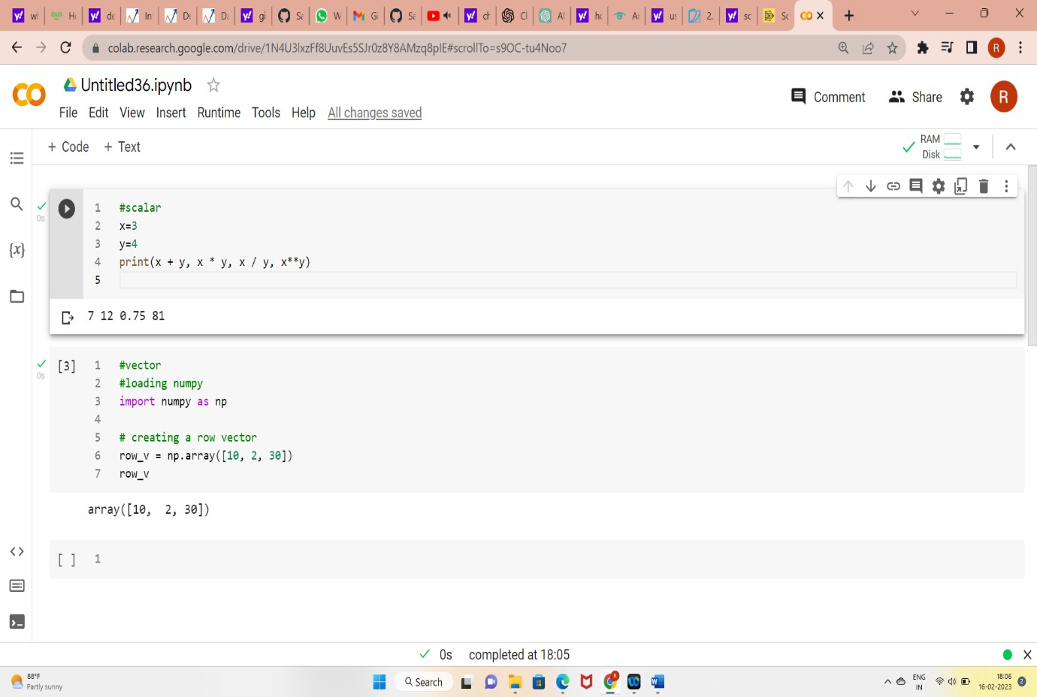
vectors: A vector is an array of numbers or a list of scalar values. The single values in the array/list of a vector are called the entries or components of the vector.
matrix:- Like vectors generalize scalars from order zero to order one, matrices generalize vectors from order one to order two. In other words, Matrices are 2- D array of numbers

Slide 6
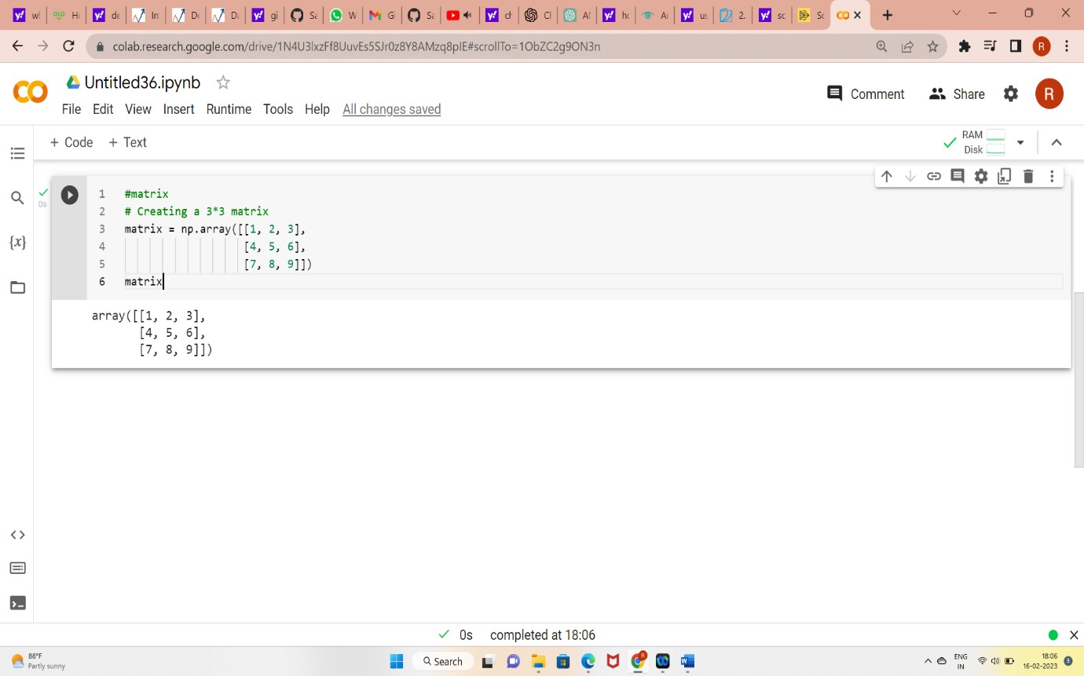
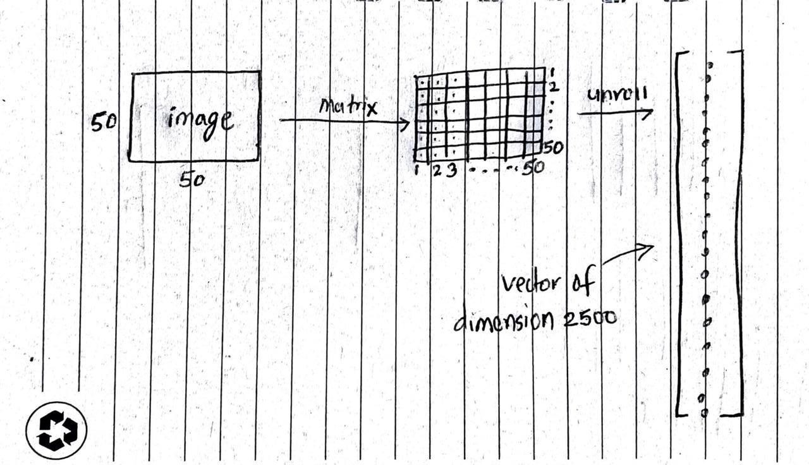
Real-world use case: The learning algorithms need numbers to work on. Data such as images have to be converted to an array of numbers before the data is fed to the algorithms. In the above illustration, an image of 50*50 is first converted to a 50*50 matrix. Here we are supposing that the image is grayscale. Thus the value of a pixel ranges from 0 to 255. The resulting image is then converted to a vector of dimension 2500. This way an image is converted to a vector.

Slide 7
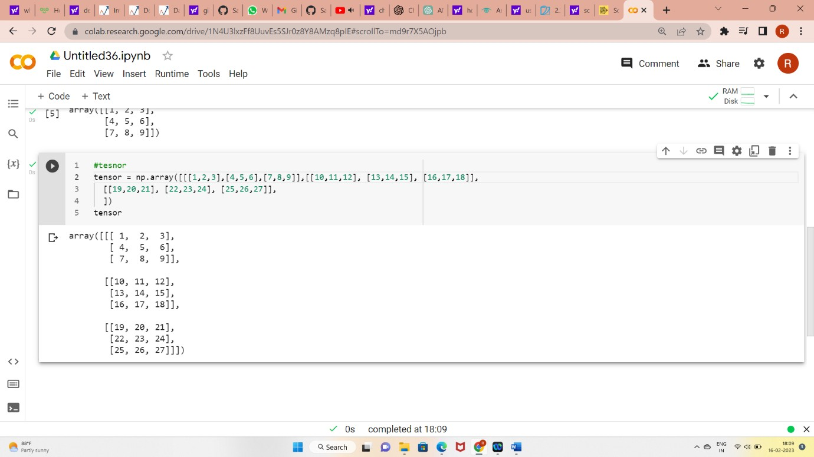
d)Tensors:- Tensors can be simply understood as an n-dimensional array with n greater than 2. Vectors are first order tensors and matrices are second order tensors.
We’ll be dealing with tensors while working with color image and video data. When a color image is converted to an array of numbers the dimension will be something like height, width and color axis. The color axis basically defines a different set of numbers for Red-Green-Blue channels. For each color channel, we’ll be creating a matrix based on the pixel value. Then the resulting matrices are unrolled to form a vector.

Slide 8
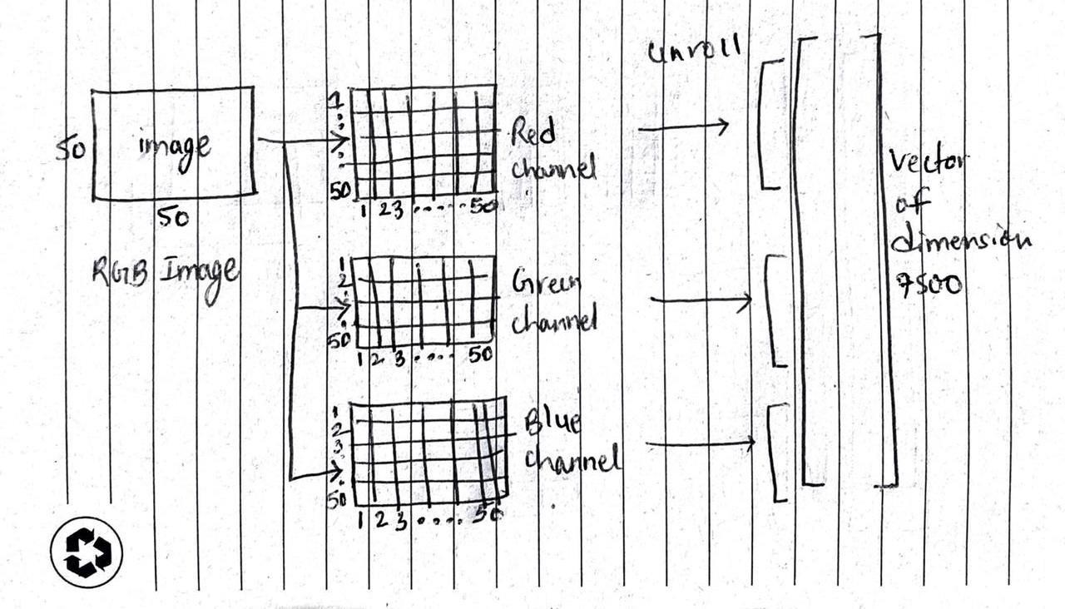
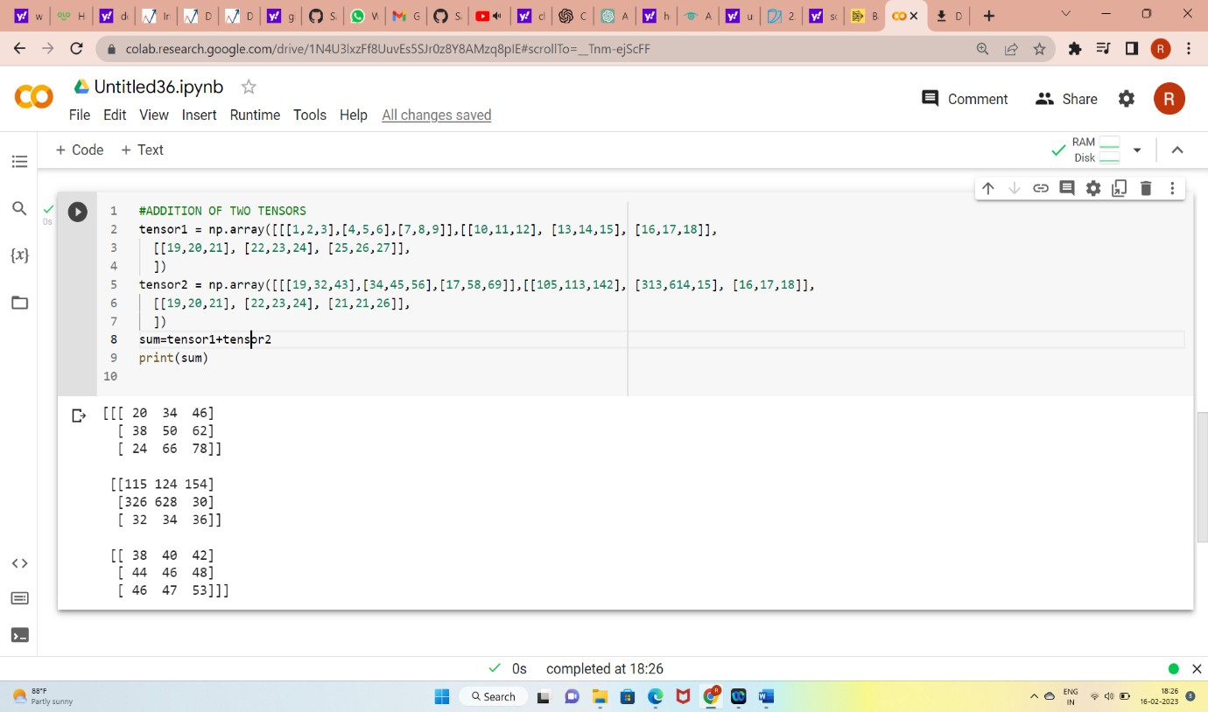
Scalar,Vectors,Matrixes,Tensors are basic fundamentals of nueral networs and hence is is essential to know them.
Basic operations on Tensors: 1)Addition
2)Broadcasting

Slide 9
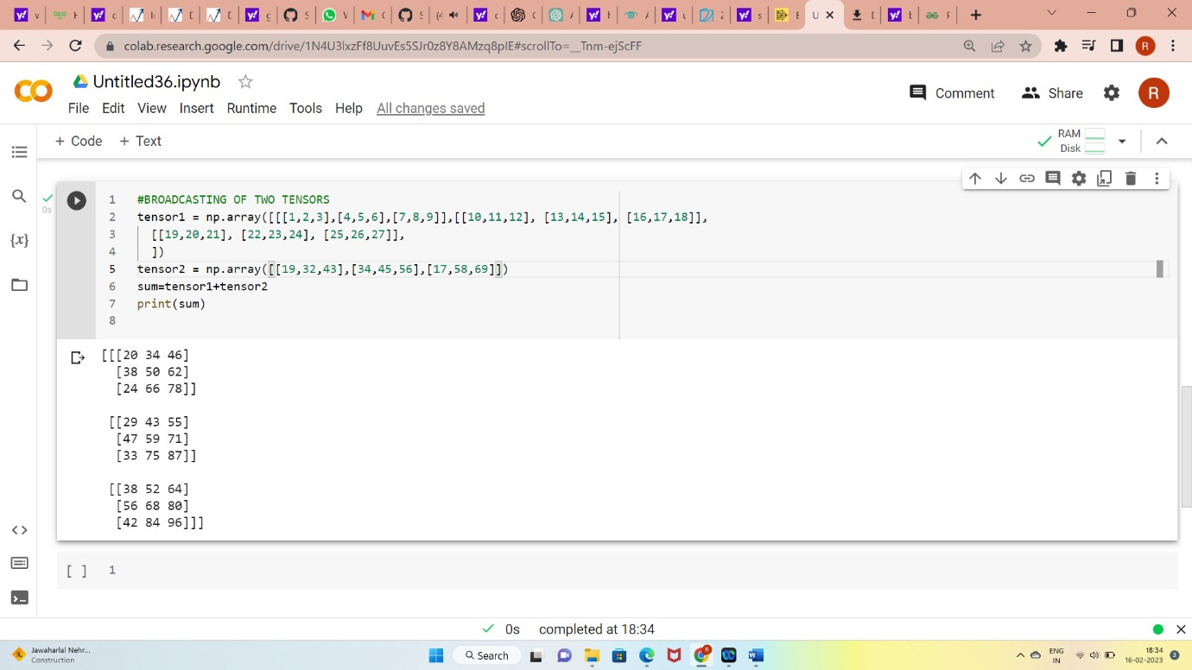
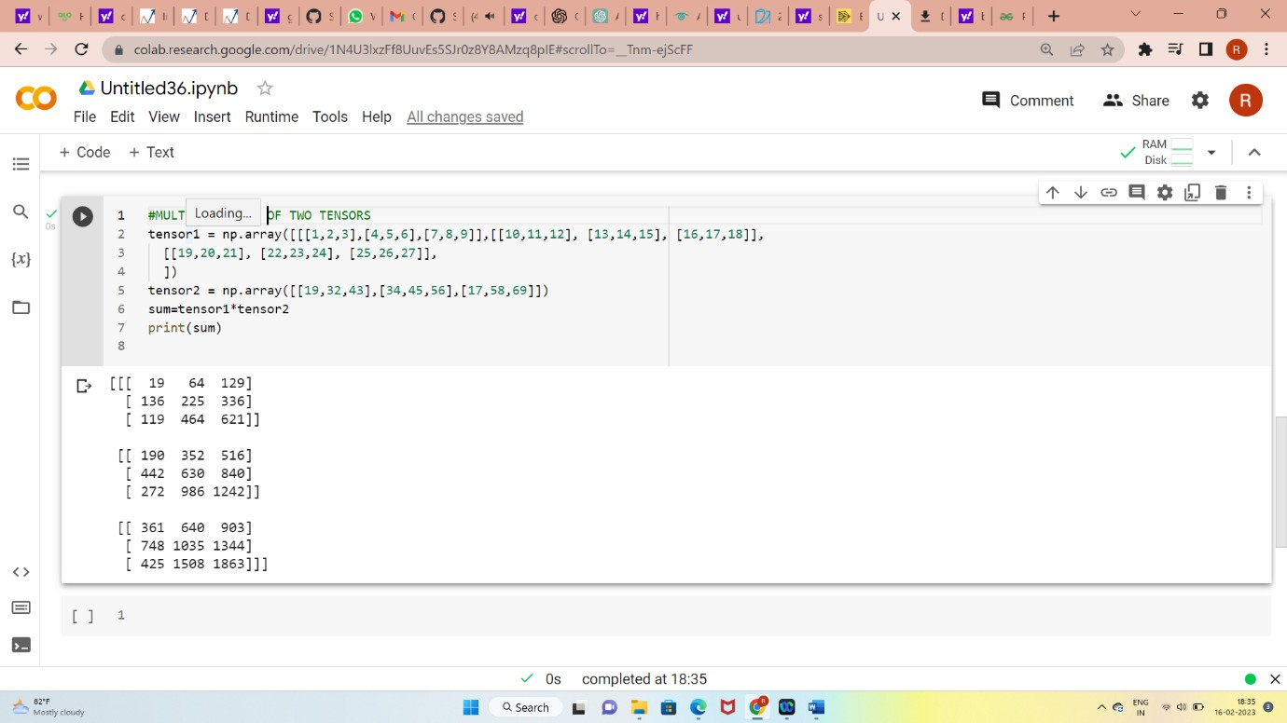
3)Multiplication
How dot product works?

Slide 10
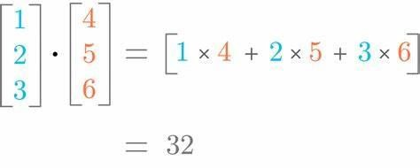
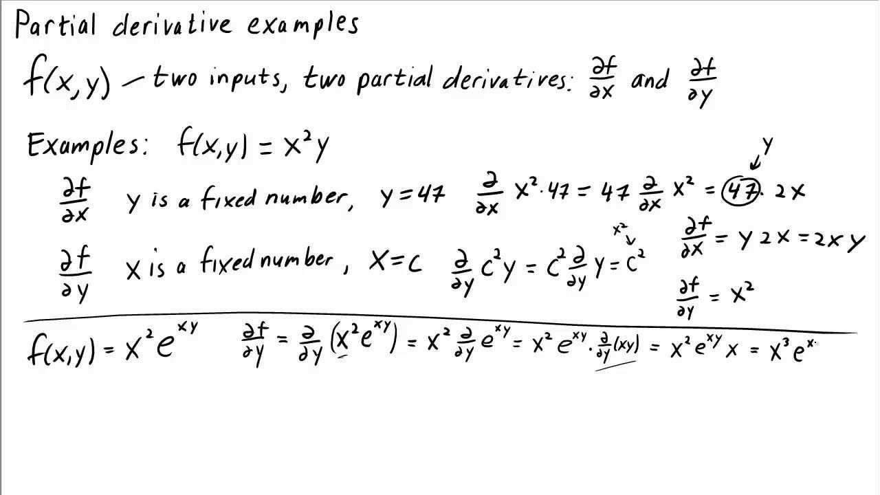
2)Calculus(partial derivatives):
HOW ANN WORKS?
A neural network is a combination of multiple layers where each layer consists of multiple units, and these layers are mainly categorized into three sections 1. An input layer, 2. Hidden layer(s), and 3. Output layer. A neural network is said to be dense layered NN. When each unit from one layer is connected to every other unit in the next layer then, it is said to be a dense, layered neural network.
The Idea of Neural Network – Perceptron

Slide 11
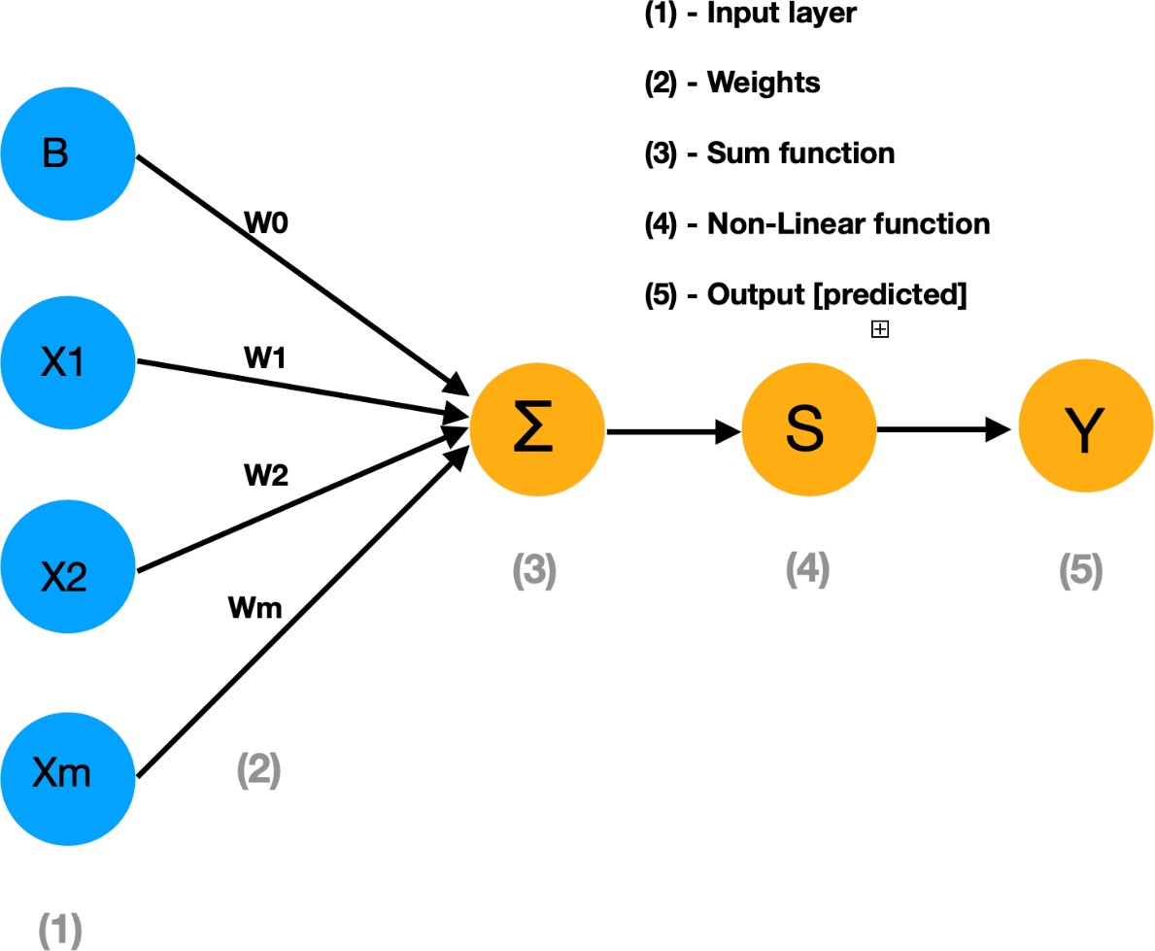
The above diagram represents the perceptron model where we have an input layer, weights respective to each unit, and SUM function [X1*W1+X2*W2+…..+XmWm] where X1 X2…Xm represents input features and W1 W2…Wm represents weights, A non-linear function which we will discuss more, and finally, the predicted output. Mathematically we write the same diagram as below:
ŷ = g (W0 + ∑ Xi * Wi)
= g (Wo + X^{T}. W), Where X^{T}= [X1,…….,Xm] & W = [W1,…….,Wm]^{T}
In a perceptron, each input is multiplied by its respective weight and taken as a sum, then passed to a non-linear function, giving us a result between zero and one.

Slide 12
Artificial neural networks (ANNs) can be used for both classification and regression tasks, but the way they are used and trained can be different.
In ANNs used for classification, the output is a categorical variable or label that represents the class or category to which the input belongs. The objective is to learn a mapping from the input features to the corresponding output class. The output of the network is often a probability distribution over all possible classes, and the class with the highest probability is chosen as the predicted class. In classification tasks, we use a different loss function such as categorical cross- entropy to minimize the difference between the predicted and actual class.
Log likelihood, softmax, and cross-entropy loss are all related concepts that are commonly used in neural networks for classification tasks. Here's an explanation of each concept:
Log likelihood: The log likelihood is a measure of the probability of observing a set of labels given a set of inputs and a probability distribution over the labels.
In the context of classification, we can use the log likelihood to measure the
probability of observing a set of true labels given a set of input features and a model that produces a probability distribution over the possible labels. The log likelihood is often used as a loss function in maximum likelihood estimation, where the goal is to find the model parameters that maximize the likelihood of the observed data. The log likelihood is calculated by taking the logarithm of the product of the predicted probabilities for the true labels.
Cross-entropy loss: Cross-entropy loss is a measure of the difference between two probability distributions. In the context of classification, we can use the cross-entropy loss to measure the difference between the predicted probability distribution and the true probability distribution over the labels. The cross- entropy loss is often used as a loss function in neural networks for classification tasks. The cross-entropy loss is calculated by taking the negative log of the predicted probability for the true label:
cross_entropy_loss = - log(predicted_probability_of_true_label)
The cross-entropy loss is often used with the softmax function to compute the predicted probabilities.
In summary, the log likelihood measures the probability of observing the true labels given the inputs and a probability distribution over the labels, the softmax function converts a vector of scores into a probability distribution over the possible labels, and the cross-entropy loss measures the difference between the predicted probability distribution and the true probability distribution over the labels. These concepts are all related and can be used in conjunction to train neural networks for classification tasks.

Slide 13
Activation functions are mathematical functions that are used in artificial neural networks (ANNs) to introduce non-linearity in the output of neurons. Non- linearity is important for ANNs to learn complex functions and patterns in the
data. Here are some commonly used activation functions in ANNs:
Sigmoid: The sigmoid function maps any real-valued input to a value between 0 and 1. It has a characteristic "S" shape and is often used as an activation function for binary classification tasks. The formula for the sigmoid function is:
sigmoid(x) = 1 / (1 + exp(-x))
ReLU (Rectified Linear Unit): The ReLU function returns 0 for any negative input and the input value for any positive input. It is one of the most commonly used activation functions in deep neural networks, as it is computationally efficient and helps to prevent the vanishing gradient problem. The formula for ReLU is:
ReLU(x) = max(0, x)
Tanh (Hyperbolic Tangent): The tanh function maps any real-valued input to a value between -1 and 1. It is similar to the sigmoid function, but has a range that is shifted and scaled. It is often used as an activation function for hidden layers in ANNs. The formula for the tanh function is:
tanh(x) = (exp(x) - exp(-x)) / (exp(x) + exp(-x))
Softmax: The softmax function is often used as an activation function for the output layer in multi-class classification tasks. It converts a vector of scores into a probability distribution over the possible classes. The formula for the softmax function is:
softmax(x_i) = exp(x_i) / sum(exp(x_j))
where x_i is the i-th element of the input vector, and the sum is taken over all elements of the vector.These are just a few examples of the many activation functions that are used in ANNs. The choice of activation function can have a significant impact on the performance of the network and should be selected based on the specific task and characteristics of the data.
BACK PROPOGATION IN ANN CLASSIFICATION:-
For classification tasks, backpropagation is used to update the weights of the network in order to minimize the cross-entropy loss between the predicted and actual class labels. The process involves propagating the errors backwards through the network from the output layer to the input layer, and computing the gradient of the loss function with respect to the weights at each layer. The weights are then updated using the gradient descent algorithm, which involves subtracting a small fraction of the gradient from the current weight values.Backpropagation is an iterative algorithm that is used to update the

Slide 14
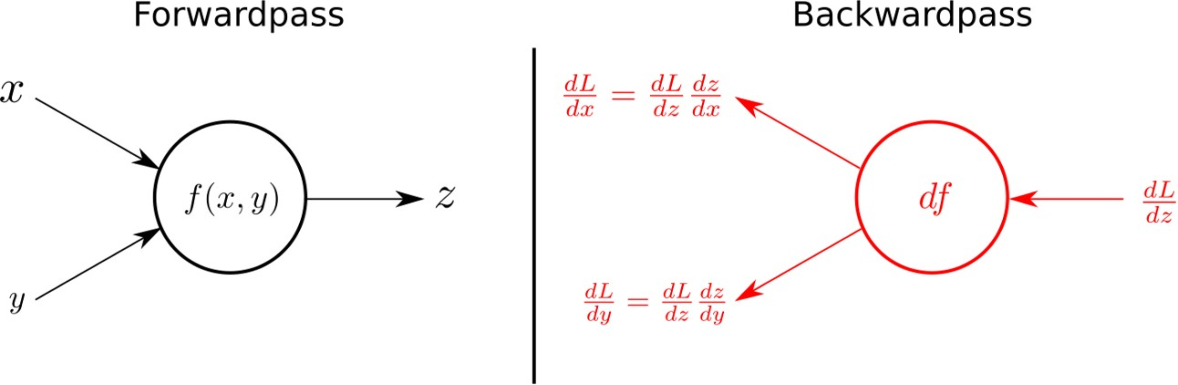
weights of the network over multiple epochs until the loss function is minimized. The use of backpropagation in classification tasks is an important component of the training process for ANNs and has been shown to be highly effective in a wide range of applications.To update the weights of the network during backpropagation for a classification task, the following steps are typically taken:
Compute the output of the neural network for a given input using a forward pass.
Compute the error or loss between the predicted output and the actual output.
Use backpropagation to compute the gradient of the loss function with respect to the weights of the network.
Use the gradient to update the weights of the network using an optimization
algorithm such as gradient descent. The update rule is typically of the form:
w = w - learning_rate * gradient
where w is a weight, learning_rate
is a small positive number (also known as
the step size), and gradient is the gradient of the loss function with respect to the weight.
Repeat steps 1-4 for multiple inputs and epochs until the network has learned to
accurately classify inputs into their correct classes.
During the backpropagation step, the gradient of the loss function with respect to the weights is computed using the chain rule of calculus. The chain rule is used to propagate the error backwards from the output layer to the input layer of the network. At each layer, the gradient is computed and used to update the weights of the network.
The specific details of the backpropagation algorithm and the optimization algorithm used to update the weights can vary depending on the specific neural network architecture and the optimization problem being solved. However, the basic principles of using backpropagation to update the weights of the network remain the same.
Paramters,hyperparamters:

Slide 15
In artificial neural networks (ANNs) for classification, there are two types of parameters: model parameters and hyperparameters.
Model Parameters: These are the weights and biases in the neural network that are learned during training. These parameters are updated by the backpropagation algorithm during training to minimize the loss function.
Hyperparameters: These are the configuration choices that are set prior to training, such as the number of hidden layers, the number of neurons in each layer, the learning rate, the activation functions, and the loss function. These choices can have a significant impact on the performance of the model, and they must be selected through experimentation and tuning.
Here are some of the most important hyperparameters to consider when training an ANN for classification:
Number of Hidden Layers: This is the number of layers in the neural network that are not the input or output layers. The optimal number of hidden layers can vary depending on the complexity of the problem being solved, and it may require experimentation to find the best value.
Number of Neurons per Hidden Layer: This is the number of neurons in each hidden layer of the neural network. Again, the optimal number of neurons per layer can vary depending on the problem being solved, and it may require experimentation to find the best value.
Learning Rate: This is the step size used in the optimization algorithm to update the weights of the neural network. A small learning rate can result in
slow convergence, while a large learning rate can result in the optimization algorithm overshooting the minimum of the loss function. This hyperparameter must be tuned to achieve the best results.
Activation Functions: These are the functions applied to the output of each
neuron to introduce non-linearity in the neural network. Common choices include the sigmoid function, the ReLU (rectified linear unit) function, and the softmax function. The choice of activation function can have a significant impact on the performance of the model.
Loss Function: This is the function that measures the difference between the predicted output and the actual output. Common choices for classification problems include cross-entropy loss and hinge loss. The choice of loss function can also have a significant impact on the performance of the model.Finding the best hyperparameters for a given problem typically involves a process of trial
and error, where the model is trained with different values for each hyperparameter and the performance is evaluated on a validation set. Grid

Slide 16
search, random search, and Bayesian optimization are common techniques used to automate this process.

